Slide 1

IMDB dataset analysis using sql
Name : Duvarakesh.R
Date : 03-03-2025
Course : DA & DS
Batch : December regular offline – RP33

Slide 2

Project Objective
Analyze movie industry trends based on audience engagement, financial success, and production patterns.
Identify key factors contributing to movie popularity, including genres, actors, and ratings.
Evaluate the impact of production companies, languages, and regional preferences on movie success.
Examine historical trends to understand shifts in filmmaking and audience preferences.
Ensure data quality by identifying missing or inconsistent values in the dataset.

Slide 3

Project Goals
Data Exploration: Understand the structure of the database and identify key insights.
Movie Performance Analysis: Determine the highest-rated and most popular movies.
Industry Contributor Insights: Identify the most influential directors, actors, and production companies.
Genre & Audience Trends: Analyze the popularity and engagement levels of different movie genres.
Time-Based Trends: Study how movie production and success have evolved over time.
Data Validation: Detect and address missing values or inconsistencies for accurate analysis

Slide 4
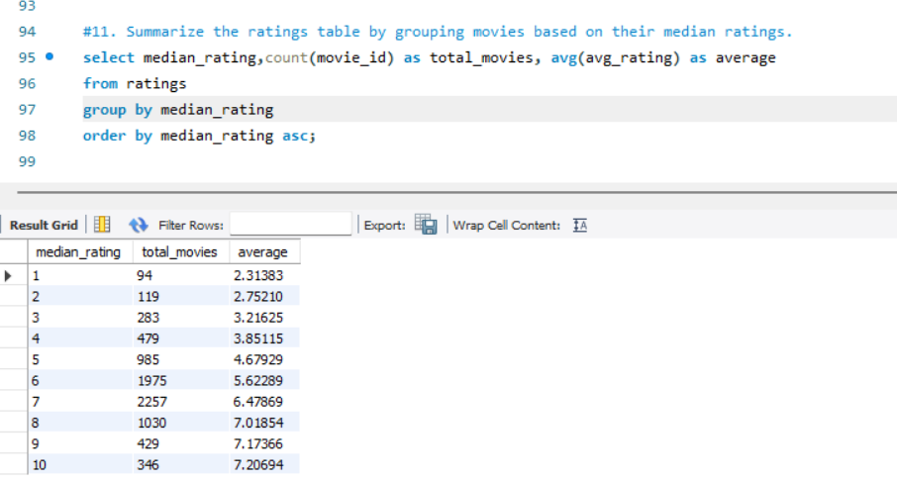
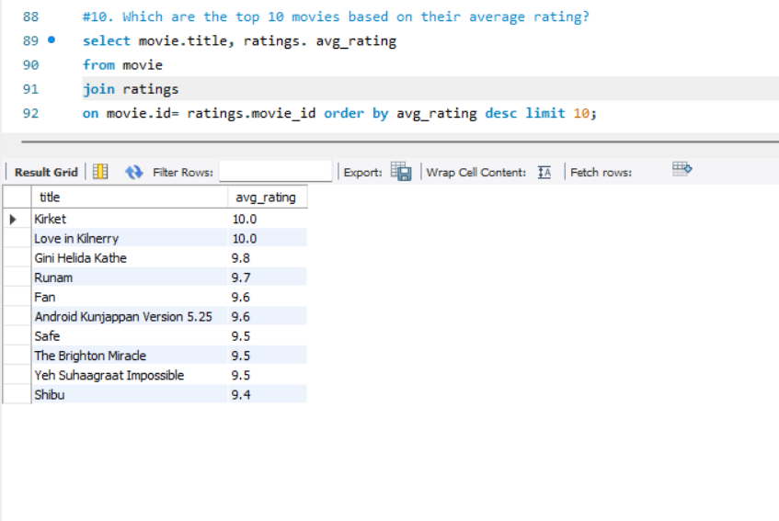
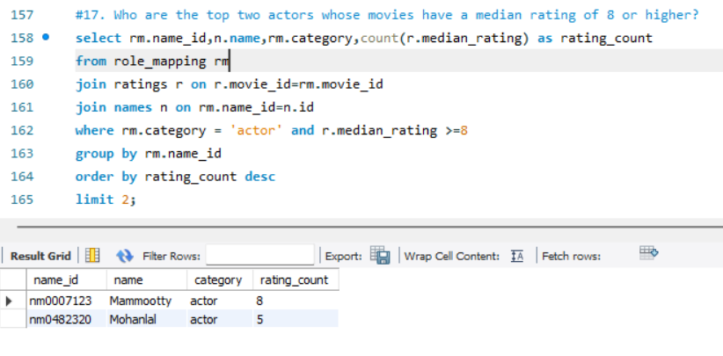
Movie Popularity & Audience Engagement
Analyzes how movies perform based on ratings, votes, and audience reception. Identifies top-rated movies, actors, and trends in viewer preferences. Helps understand what factors contribute to a movie’s popularity.

Slide 5
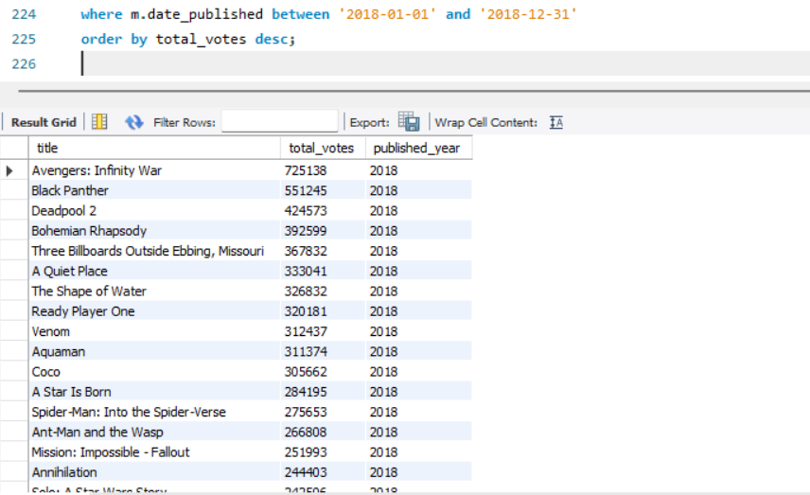
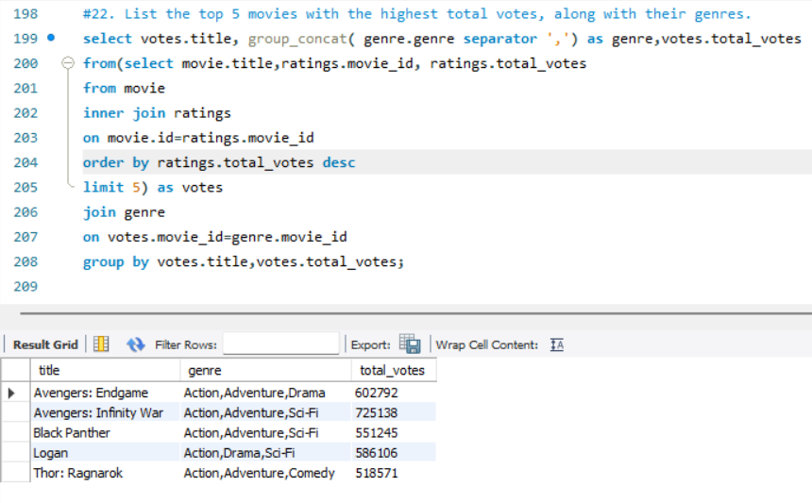
Movie Popularity & Audience Engagement
Analyzes how movies perform based on ratings, votes, and audience reception. Identifies top-rated movies, actors, and trends in viewer preferences. Helps understand what factors contribute to a movie’s popularity.

Slide 6
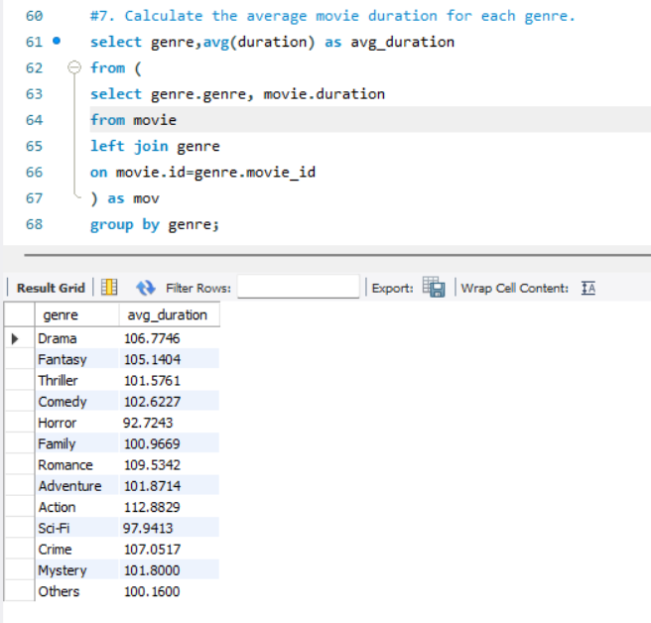
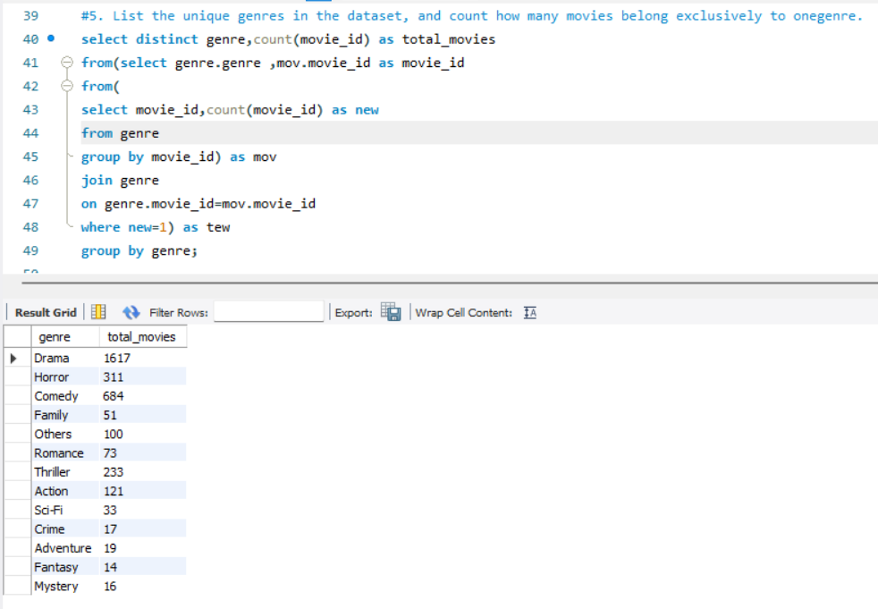
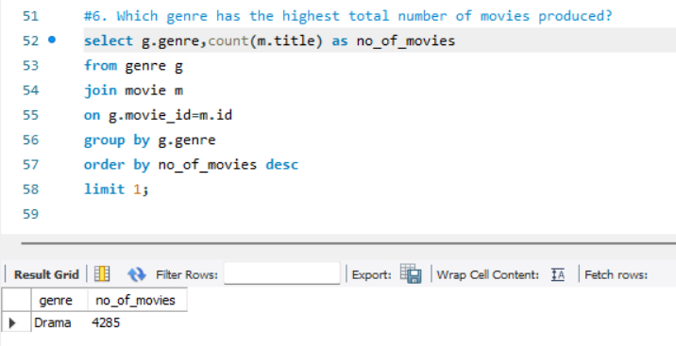
Genre & Content Trends
Examines how different genres perform in terms of movie count, duration, and audience preferences. Helps identify the most popular genres and content patterns. Provides insights into genre-based storytelling trends over time.

Slide 7
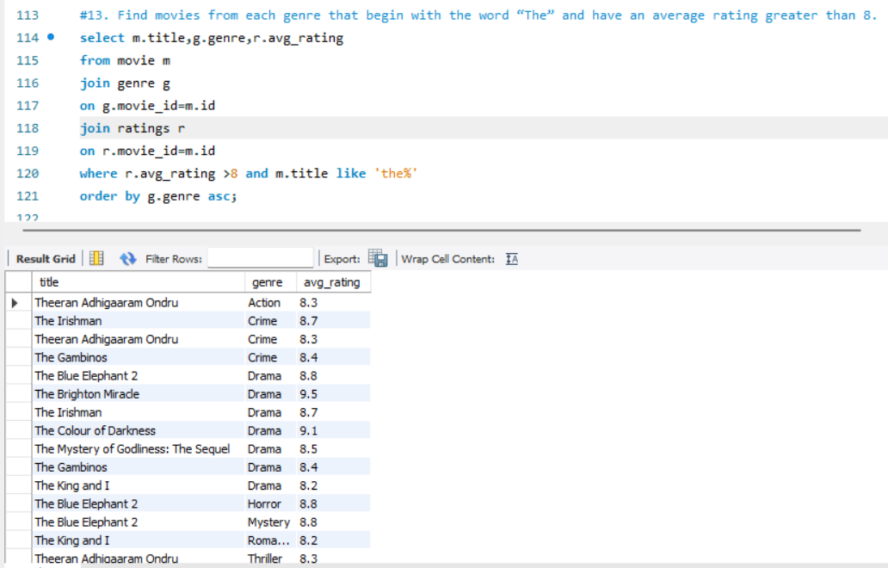
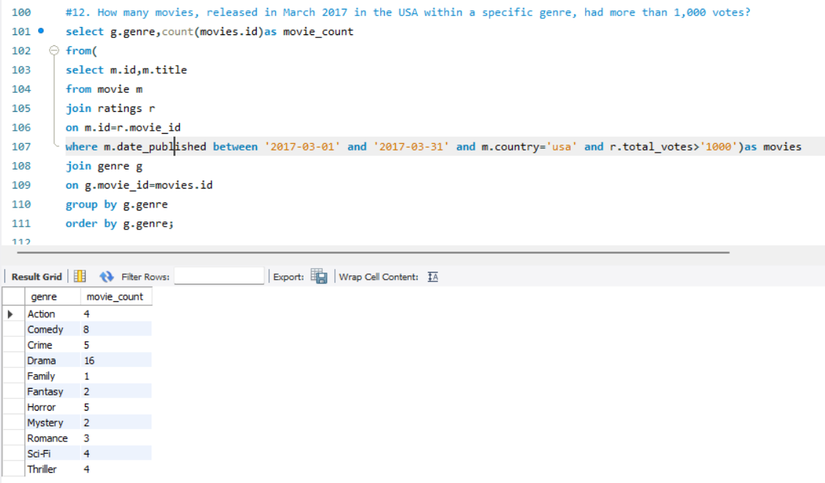
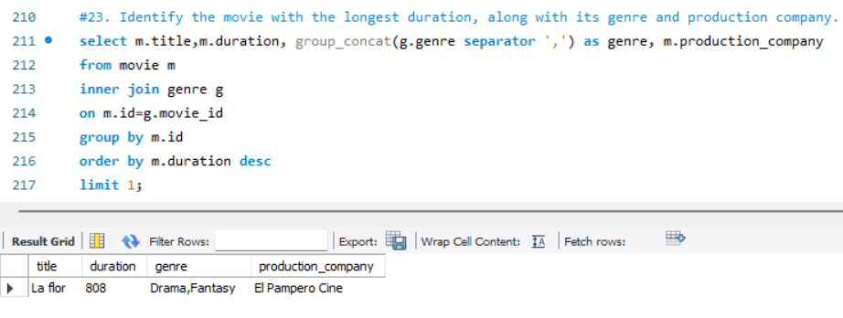
Genre & Content Trends
Examines how different genres perform in terms of movie count, duration, and audience preferences. Helps identify the most popular genres and content patterns. Provides insights into genre-based storytelling trends over time.

Slide 8
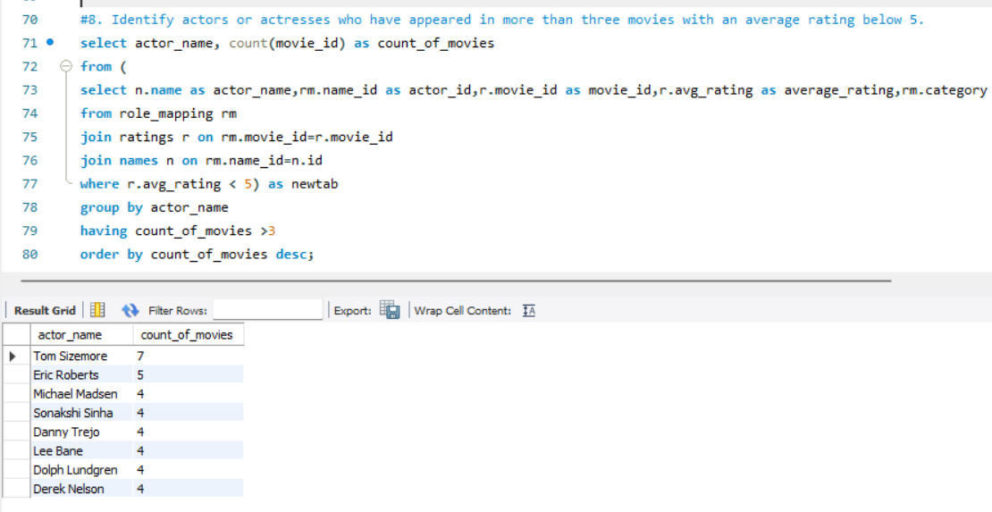
Directors, Actors & Industry Contributors
Explores the impact of directors, actors, and other industry professionals on movie success. Highlights the most influential figures based on the number of movies and ratings. Useful for understanding industry leadership and performance.

Slide 9
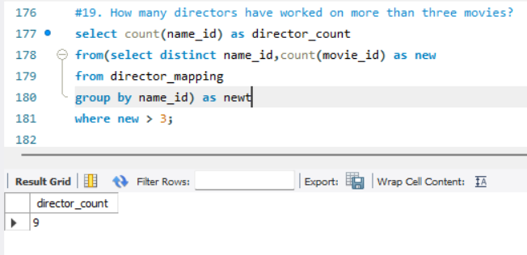
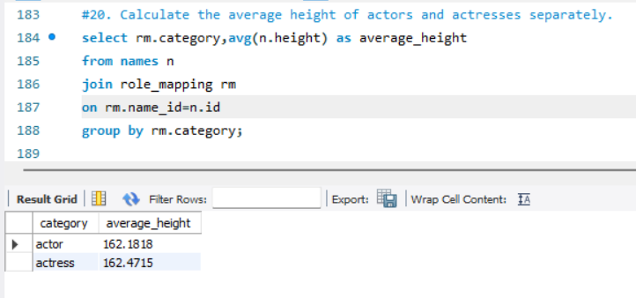
Directors, Actors & Industry Contributors
Explores the impact of directors, actors, and other industry professionals on movie success. Highlights the most influential figures based on the number of movies and ratings. Useful for understanding industry leadership and performance.

Slide 10
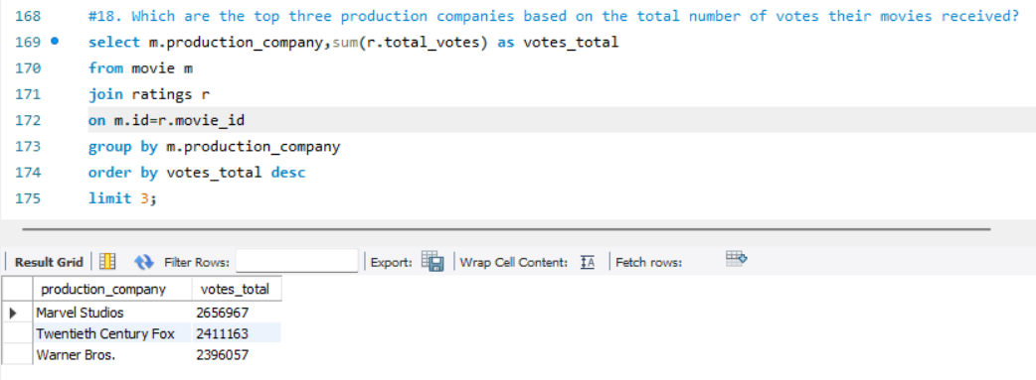
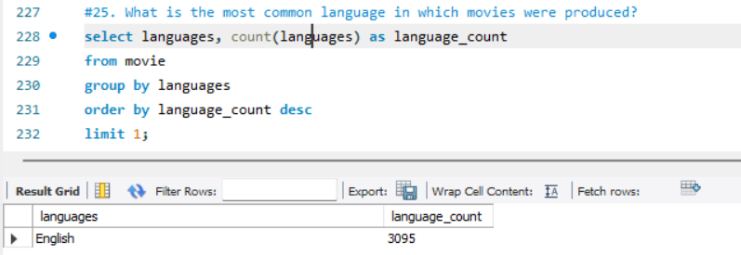
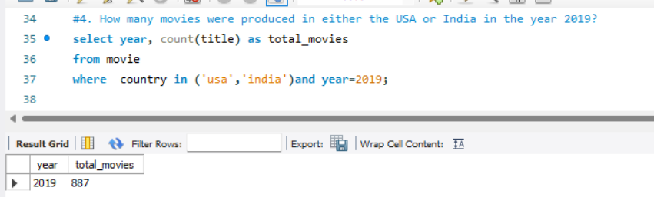
Production & Language Distribution
Analyzes which countries and languages dominate movie production. Helps identify trends in global cinema and the influence of production companies. Useful for understanding regional movie preferences and international reach.

Slide 11
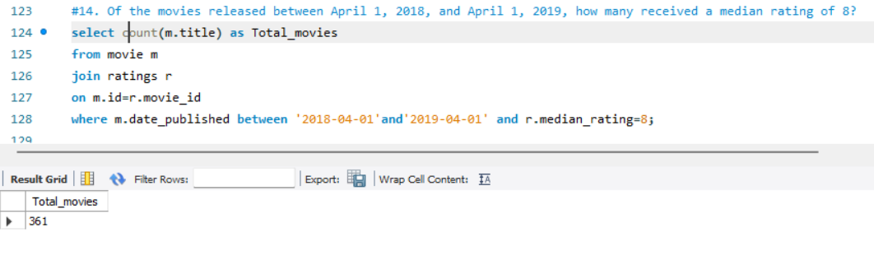
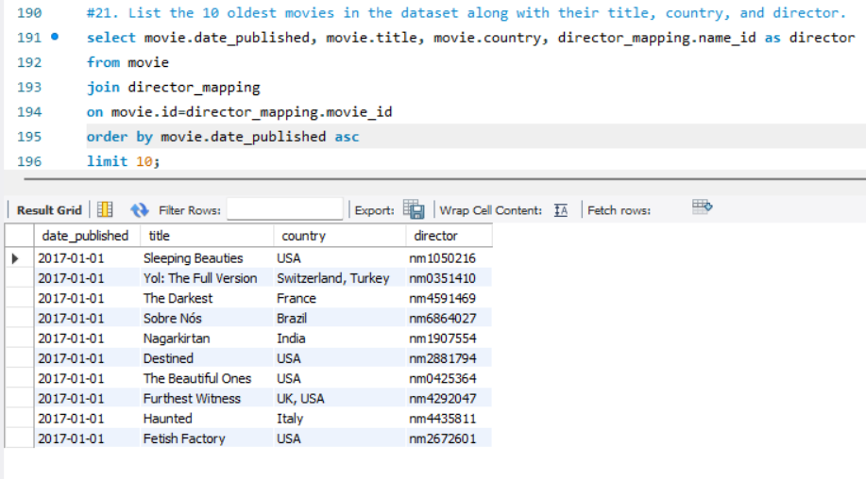
Time-Based Analysis & Trends
Studies movie trends based on release years, seasonal patterns, and historical significance. Helps track changes in audience preferences and industry evolution. Useful for identifying major shifts in filmmaking over different periods.

Slide 12
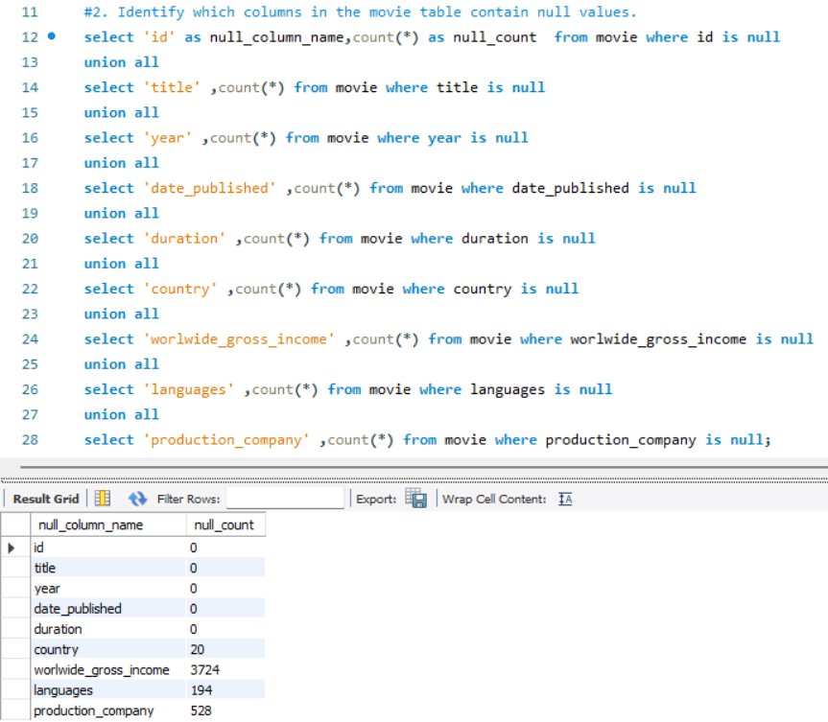
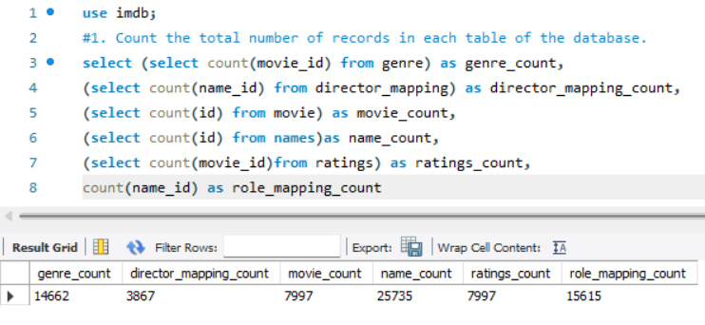
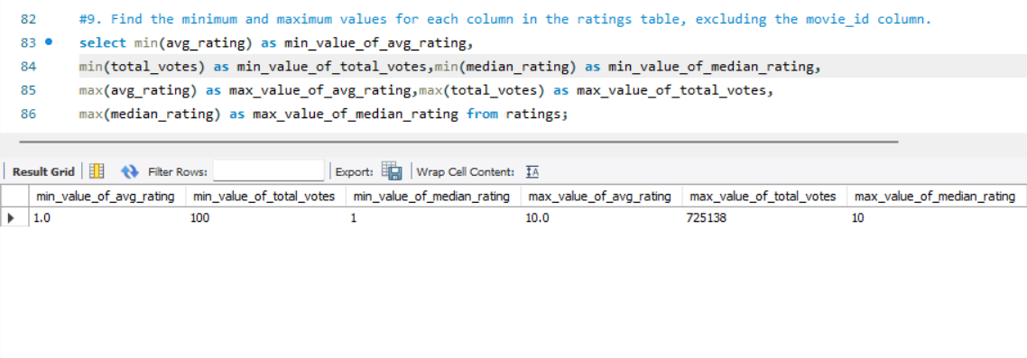
Data Quality & Validation
Identifies missing values, NULL data, and inconsistencies in the dataset. Ensures data accuracy and completeness for better insights. Essential for making reliable data-driven decisions in movie analysis.

Slide 13
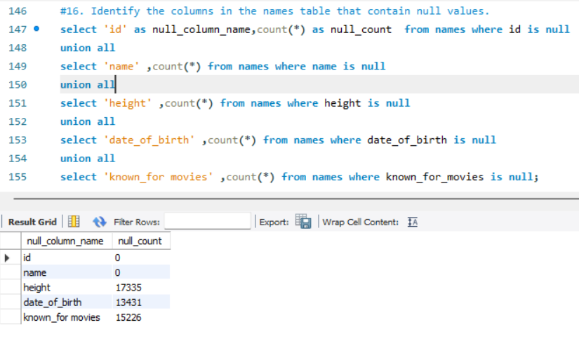
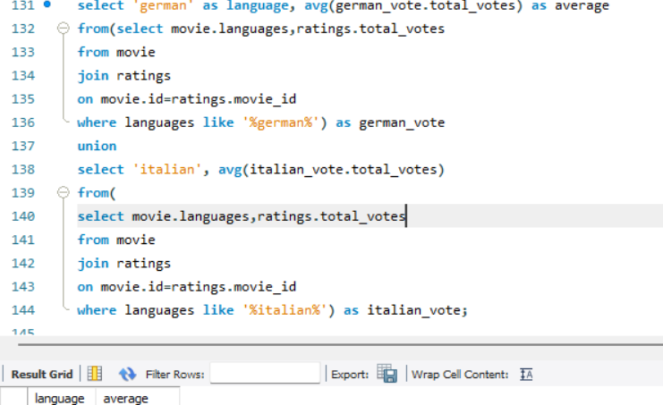
Data Quality & Validation
Identifies missing values, NULL data, and inconsistencies in the dataset. Ensures data accuracy and completeness for better insights. Essential for making reliable data-driven decisions in movie analysis.

Slide 14

Insights
Popular Genres: Drama and Action dominate movie production.
Ratings Impact: Higher-rated movies get more audience engagement.
Top Studios: A few production companies lead the industry.
Movie Duration: Action films are longer; Comedy/Horror are shorter.
Regional Influence: USA & India produce the most movies.
Director/Actor Effect: Some consistently create high or low-rated films.
Yearly Trends: Movie production varies over time.
Data Gaps: Missing values affect analysis accuracy.

Slide 15

Thank you

